Slide 1
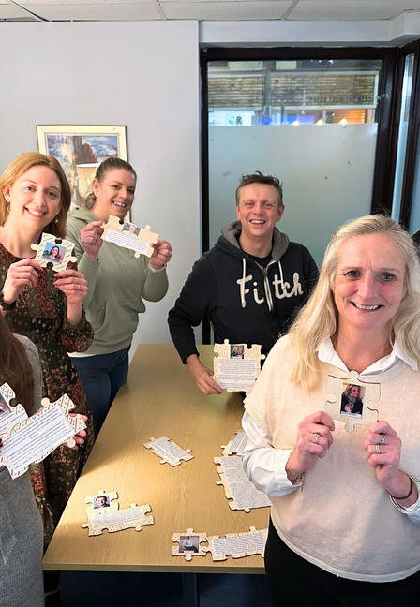






Recovery Cymru
Training & Consultancy
Professional, peer-led training on the use of alcohol and other drugs, recovery, and wellbeing.

Slide 2

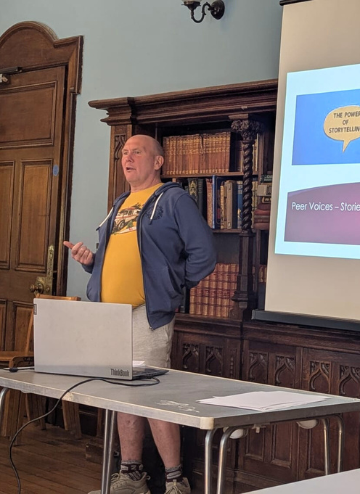



1
GROUNDED IN LIVED EXPERIENCE
Training
2
PRACTICAL AND APPLICABLE
Benefits
3
REDUCES STIGMA AND BUILDS CONFIDENCE
4
IMPROVES CONNECTION AND ENGAGEMENT
5
CREATES LASTING CULTURAL CHANGE

Slide 3
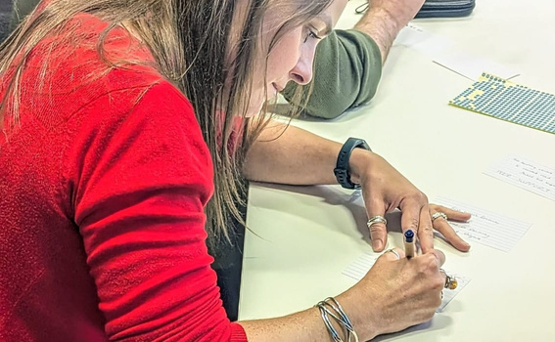

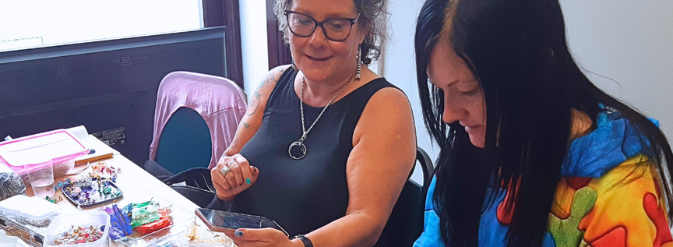

Our Courses
1
DELIVERING PEER SUPPORT
2
IMPLEMENTING PEER SUPPORT IN SERVICES
3
MANAGING THE USE OF ALCOHOL & OTHER DRUGS IN THE WORKPLACE
4
WELLBEING IN THE WORKPLACE
Our courses turn experience into action, giving people the tools and confidence to create lasting change.
They can be in-person, online and are bespoke to your individual needs.
5
UNDERSTANDING ALCOHOL AND OTHER DRUG USE

Slide 4

Delivering
Peer Support
The value of peer support and the power of lived experience are well recognised in helping people overcome difficulties with alcohol and other drugs. Quality training and support for those with lived experience are vital to ensure peer supporters feel confident, equipped and effective in their roles.
This comprehensive course was developed by people with lived experience of recovery and of delivering peer support and mutual aid both in the community and within alcohol and drug services. It builds confidence, awareness and practical skills for people who want to use their experiences to support others and develop personally and professionally.
Participants learn skills and knowledge specific to offering peer support, volunteering or working in the alcohol and other drugs field. The training complements existing induction or development programmes and provides a strong foundation for people stepping into roles such as recovery champions, recovery navigators or peer supporters.
Our trainers combine professional practice with lived experience. Sessions are interactive, informative and engaging, using group work, discussion, film and activities.

Slide 5
By the end of the course, participants will:
• Understand different peer support roles
• Recognise opportunities and challenges in peer support
• Share their experiences safely and effectively
• Develop practical peer support skills
• Understand professional boundaries and good practice
Each course includes:
• A pre-course intake conversation
• Access to training resources and online materials
• A certificate of completion
• Up to one hour of one-to-one follow-up support within three months
• A discount on future Recovery Cymru training
Delivering
Peer Support
This training can be purchased per participant or delivered to groups. It provides assurance to services seeking robust, accredited training for volunteers or staff with lived experience.

Slide 6


Well-being
“Really enjoyed it — useful outside of work as well.”
in the Workplace
Alcohol and other drug use can affect anyone. It impacts wellbeing, relationships and performance, often going unnoticed for a long time and closely linked to mental health. When this happens, the effects reach beyond the individual and into families, communities and workplaces.
Across the UK, alcohol harm costs society more than £27 billion every year, and businesses lose around 17 million working days to alcohol-related sickness, estimated to cost £7 billion annually (Institute of Alcohol Studies, 2023; Association of Directors of Public Health, 2023).
When alcohol and other drug use are combined, the total cost to the UK is estimated at over £30 billion each year (HM Government, 2021).
Because most people affected are in work, organisations often feel the impact first. Building understanding helps reduce stigma, makes it easier for people to seek help, and gives managers the confidence to handle sensitive situations with care and compassion.
As part of your workplace wellbeing commitment, Recovery Cymru offers a complimentary 1.5-hour awareness session. Each session includes real stories from members and staff, practical insights and a Q&A tailored to your organisation.
These sessions fit well into wellbeing programmes, awareness days or conferences and can be delivered online or in person.
For teams who want to go further, we also offer Managing Alcohol and Other Drug Concerns in the Workplace, a practical training course focused on real understanding and confident responses.

Slide 7
Implementing Peer Support
in Services
The power of peer support and lived experience in recovery is well known. Visible recovery and connection between peers improve engagement, outcomes and culture in any service.
This course explores how to build that into your organisation. It’s informed by people with lived experience of recovery and by those who’ve worked in alcohol and other drug services. It’s designed for people who want to understand how lived experience can strengthen support, shape culture, and improve the way services work.
What you’ll cover:
What peer support and lived experience mean in practice
Different models of peer delivery, from mutual aid to recovery coaching
Benefits of peer support for people and for services
Barriers, culture clashes and how to overcome them
Standards, quality and outcomes that matter
Practical planning for introducing or expanding peer support

Slide 8
What you’ll gain:
A clear understanding of how to apply peer support in service settings
Confidence to address challenges and build on opportunities
Practical ideas you can use immediately to strengthen recovery outcomes
Participants receive:
Pre-session consultation to shape the training to your organisation
Course materials and resources
Certificate of completion
Optional one-to-one follow-up support
This training is ideal for managers, practitioners and commissioners who want to embed recovery-focused, peer-led practice in their work.
Implementing Peer Support
in Services

Slide 9
Managing the use of
Alcohol & Other Drugs in the Workplace
Alcohol and other drug use affects well-being, safety and performance in every kind of workplace. Understanding it helps organisations create safer, more supportive environments where people can thrive.
This course builds confidence for managers and teams to recognise early signs, start conversations and take action that balances care with accountability. It also explores how workplace culture and policy shape responses to alcohol and drug use and how to manage complex or sensitive situations with confidence.
What you’ll cover
The impact of alcohol and drug use in the workplace
How to recognise early signs and understand their effect
Approaching and handling concerns constructively
Balancing wellbeing, safety and legal responsibilities
Organisational culture, risk and staff support
When and how to seek specialist advice
What you’ll gain
Practical tools for responding effectively and confidently
Strategies for prevention and early intervention
Knowledge to reduce risk and support staff wellbeing
Participants receive
Pre-session consultation to tailor the training
Course materials and certificate of completion
Optional follow-up support
This training helps create workplaces where people feel supported, understood and accountable, and where recovery and wellbeing are part of the culture.

Slide 10
Understanding the Use of
Alcohol and Other Drugs
(For non-specialist services)
People who use alcohol or other drugs often come into contact with housing, mental health, social care and other frontline services long before they reach specialist support. Many workers want to help but feel unsure how to approach these situations.
This course builds understanding, confidence and basic skills for engaging with people who use alcohol and other drugs. It explores the realities of use and recovery, stigma and preconceptions, and the simple ways professionals can make a positive difference in day-to-day interactions.
What you’ll cover:
How alcohol and drug use affects engagement with services
Recovery, change and the role of lived experience
Stigma, language and the impact of assumptions
Practical tools for supportive conversations
When and how to refer or signpost
What you’ll gain:
Greater confidence and awareness
Practical communication skills
Stronger working relationships across services
This training is ideal for professionals and volunteers in housing, health, social care, education, justice and community roles.

Slide 11


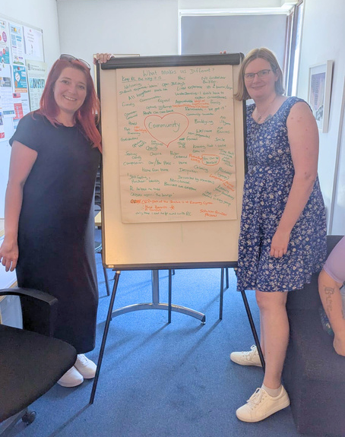
Ready
to explore?
REACH OUT TO SEE HOW WE CAN TAILOR OUR COURSES TO YOUR NEEDS.
EMAIL
INFO@RECOVERYCYMRU.ORG.UK
PHONE
07944 851 050

